Slide 1
COMP4901K/Math4824B Machine Learning for Natural Language Processing
Lecture 18: Language Models
Instructor: Yangqiu Song
Slides credits: Hongning Wang

Slide 2
What is a statistical LM?
A model specifying probability distribution over word sequences
p(“Today is Wednesday”) ≈ 0.001
p(“Today Wednesday is”) ≈ 0.0000000000001
p(“The eigenvalue is positive”) ≈ 0.00001
It can be regarded as a probabilistic mechanism for “generating” text, thus also called a “generative” model

Slide 3
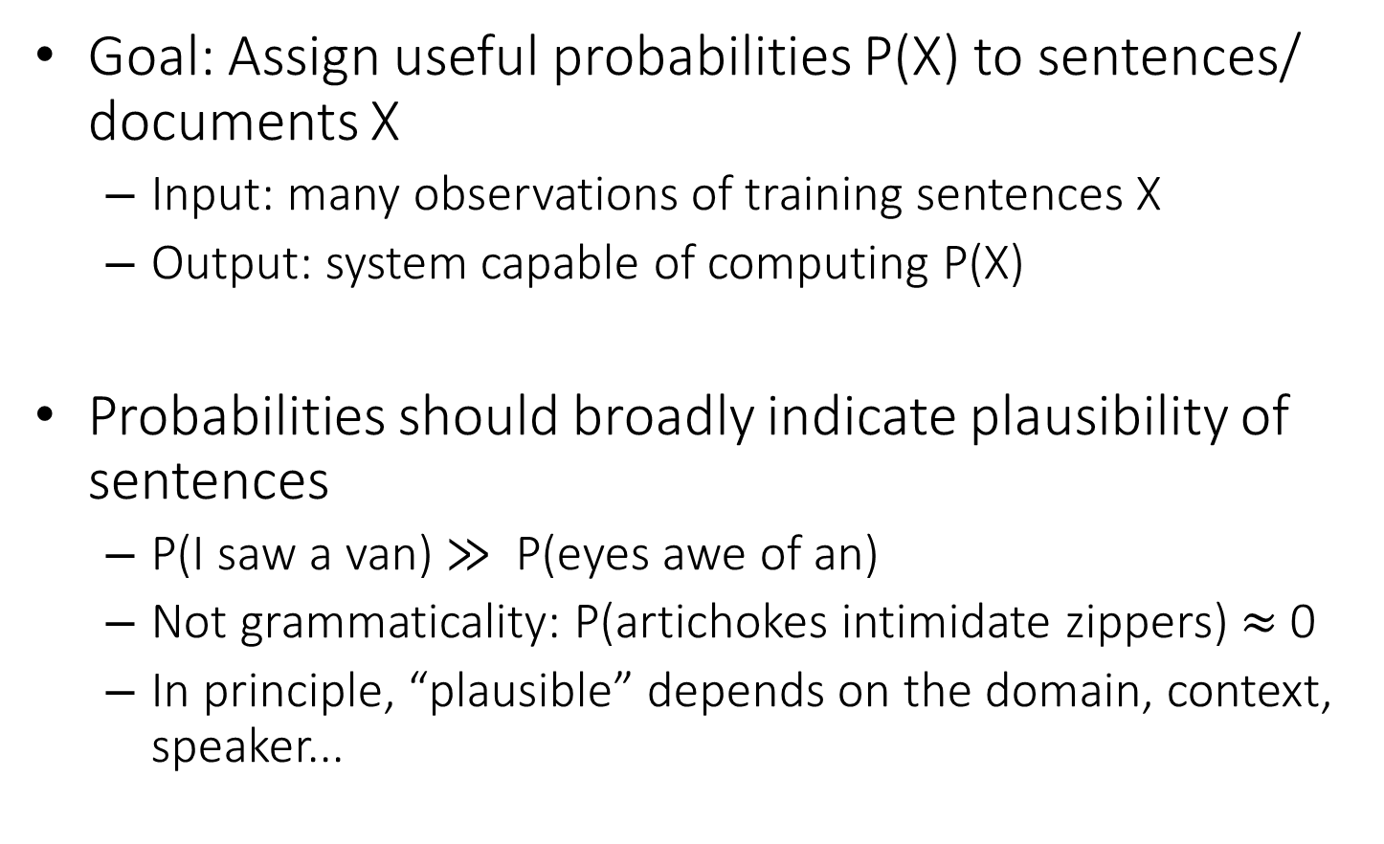
Language Model for Text
Goal: Assign useful probabilities P(X) to sentences/ documents X
Input: many observations of training sentences X
Output: system capable of computing P(X)
Probabilities should broadly indicate plausibility of sentences
P(I saw a van) $≫$ P(eyes awe of an)
Not grammaticality: P(artichokes intimidate zippers) $≈$ 0
In principle, “plausible” depends on the domain, context, speaker...

Slide 4



Language model for text
We need independence assumptions!
Probability distribution over word sequences
$p\left(w1 w2 … wn\right)=p\left(w1\right)p\left(w_{2} | w_{1}\right)p\left(w_{3} | w_{1},w_{2}\right)…p\left(w_{n} | w_{1},w_{2},…,w_{n−1}\right)$
Complexity - $O(V^{n^{∗}})$
$n^{∗}$ - maximum document length
sentence
Chain rule: from conditional probability to joint probability
475,000 main headwords in Webster's Third New International Dictionary
Average English sentence length is 14.3 words
A rough estimate: $O({475000}^{14})$
How large is this?
$$≈3.38e^{66}TB$$

Slide 5

Unigram language model
Generate a piece of text by generating each word independently
$p(w1 w2 … wn)=p(w1)p(w2)…p(wn)$
Looks familiar?
Essentially a multinomial distribution over the vocabulary
The simplest and most popular choice!

Slide 6
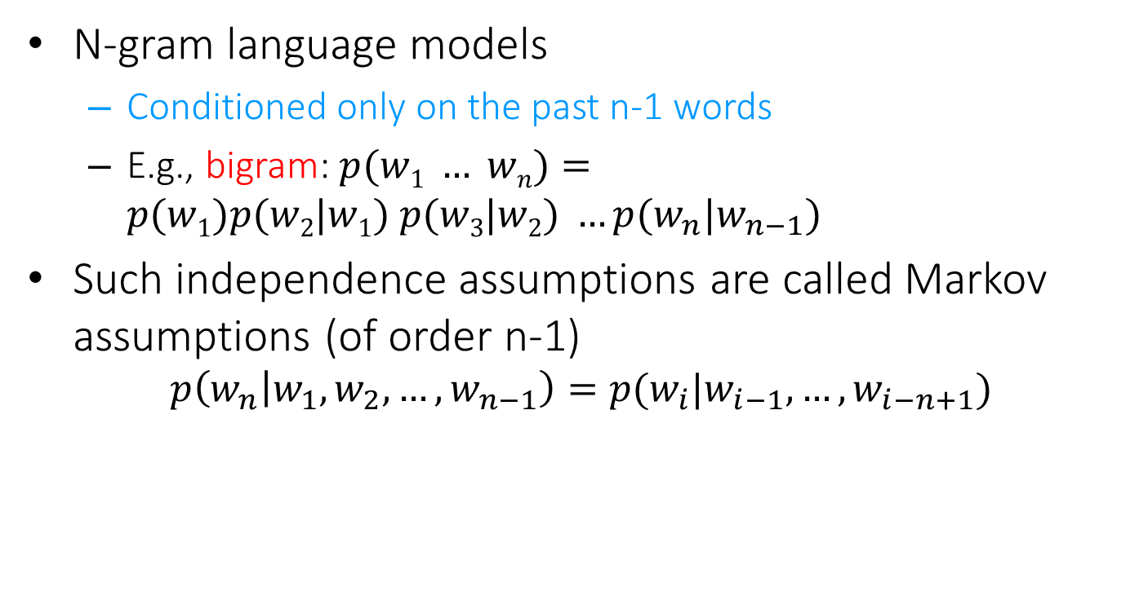
More sophisticated LMs
N-gram language models
Conditioned only on the past n-1 words
E.g., bigram: $p(w1 … wn)=p(w1)p(w2|w1) p(w3|w2) …p(w_{n}|w_{n−1})$
Such independence assumptions are called Markov assumptions (of order n-1)
$$p\left(w_{n} | w_{1},w_{2},…,w_{n−1}\right)=p(w_{i}|w_{i−1},…,w_{i−n+1})$$

Slide 7
Why just unigram models?
Difficulty in moving toward more complex models
They involve more parameters, so need more data to estimate
They increase the computational complexity significantly, both in time and space
Capturing word order or structure may not add so much value for “topical inference”
But, using more sophisticated models can still be expected to improve performance ...

Slide 8
Generative view of text documents
(Unigram) Language Model θ
p(w| θ)
Sampling
Document
…
text 0.2
mining 0.1
assocation 0.01
clustering 0.02
…
food 0.00001
…
Topic 1:
Text mining
Text mining
document
…
text 0.01
food 0.25
nutrition 0.1
healthy 0.05
diet 0.02
…
Food nutrition
document
Topic 2:
Health

Slide 9
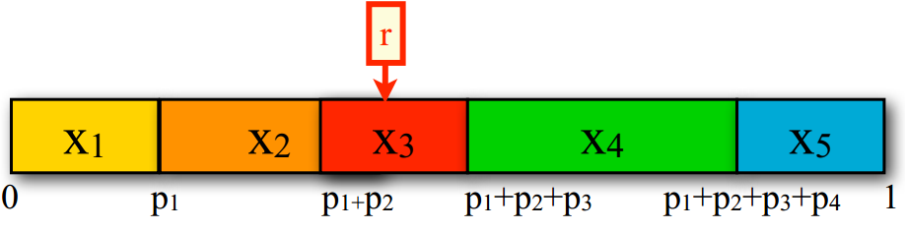

How to generate text from an N-gram language model?
Sample from a discrete distribution $p(X)$
Assume $n$ outcomes in the event space $X$
Divide the interval [0,1] into $n$ intervals according to the probabilities of the outcomes
Generate a random number $r$ between 0 and 1 (By uniform)
Return $x_{i}$ where $r$ falls into

Slide 10
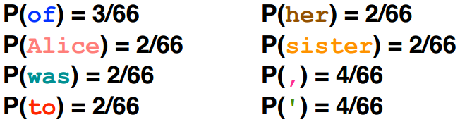
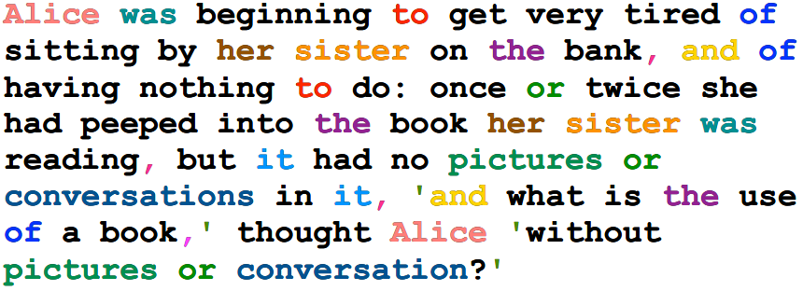
Generating text from language models
Under a unigram language model:

Slide 11
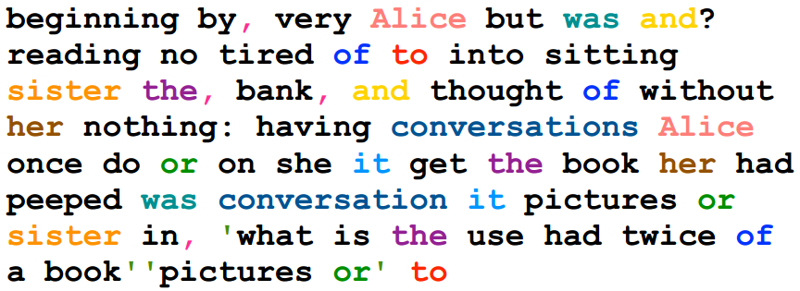
Generating text from language models
Under a unigram language model:
The same likelihood!

Slide 12
N-gram language models will help
Unigram
Months the my and issue of year foreign new exchange’s september were recession exchange new endorsed a q acquire to six executives.
Bigram
Last December through the way to preserve the Hudson corporation N.B.E.C. Taylor would seem to complete the major central planners one point five percent of U.S.E. has already told M.X. corporation of living on information such as more frequently fishing to keep her.
Trigram
They also point to ninety nine point six billon dollars from two hundred four oh six three percent of the rates of interest stores as Mexico and Brazil on market conditions.
Generated from language models of New York Times

Slide 13
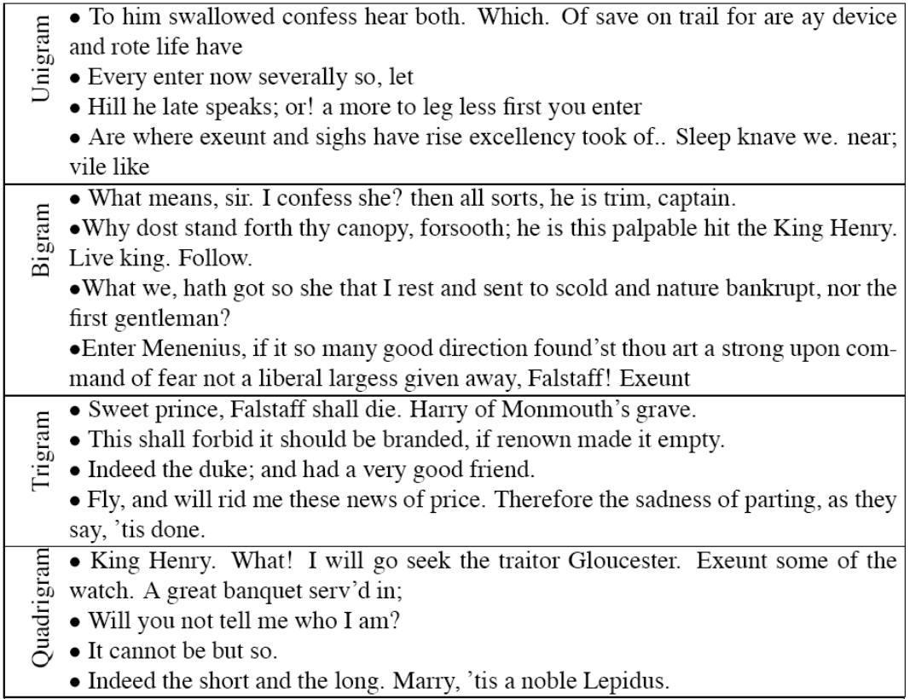

Turing test: generating Shakespeare
A
B
SCIgen - An Automatic CS Paper Generator
C
D

Slide 14
Estimation of language models
Unigram Language Model θ
p(w| θ)=?
Estimation
Document
…
text ?
mining ?
assocation ?
database ?
…
query ?
…
text 10
mining 5
association 3
database 3
algorithm 2
…
query 1
efficient 1
A “text mining” paper
(total #words=100)

Slide 15
Estimation of language models
Maximum likelihood estimation
Unigram Language Model θ
p(w| θ)=?
Estimation
Document
…
text ?
mining ?
assocation ?
database ?
…
query ?
…
text 10
mining 5
association 3
database 3
algorithm 2
…
query 1
efficient 1
10/100
5/100
3/100
3/100
1/100
A “text mining” paper
(total #words=100)

Slide 16
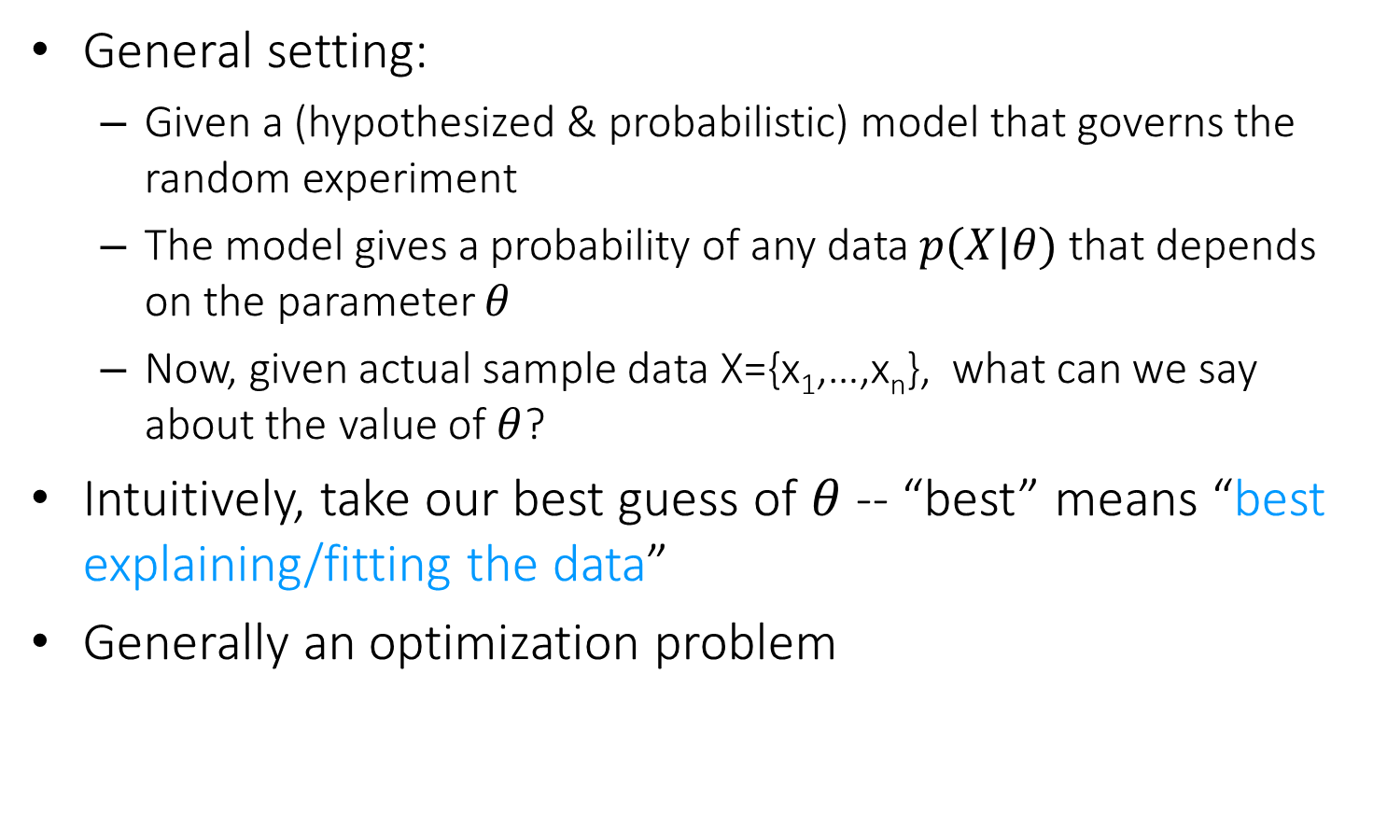
Parameter estimation
General setting:
Given a (hypothesized & probabilistic) model that governs the random experiment
The model gives a probability of any data $p(X|θ)$ that depends on the parameter $θ$
Now, given actual sample data X={x₁,…,x_{n}}, what can we say about the value of $θ$?
Intuitively, take our best guess of $θ$ -- “best” means “best explaining/fitting the data”
Generally an optimization problem

Slide 17

Maximum likelihood vs. Bayesian
Maximum likelihood estimation
“Best” means “data likelihood reaches maximum”
Issue: small sample size
Maximum a Posterior estimation (MAP) estimation
“Best” means being consistent with our “prior” knowledge and explaining data well
Issue: how to define prior?
$$\hat{θ}={argmax}_{θ}P(X|θ)$$
ML: Frequentist’s point of view
$$\hat{θ}={argmax_{θ}P\left(θ | X\right)=argmax}_{θ}P\left(X | θ\right)P(θ)$$
MAP: Bayesian’s point of view

Slide 18
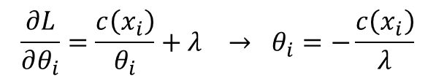
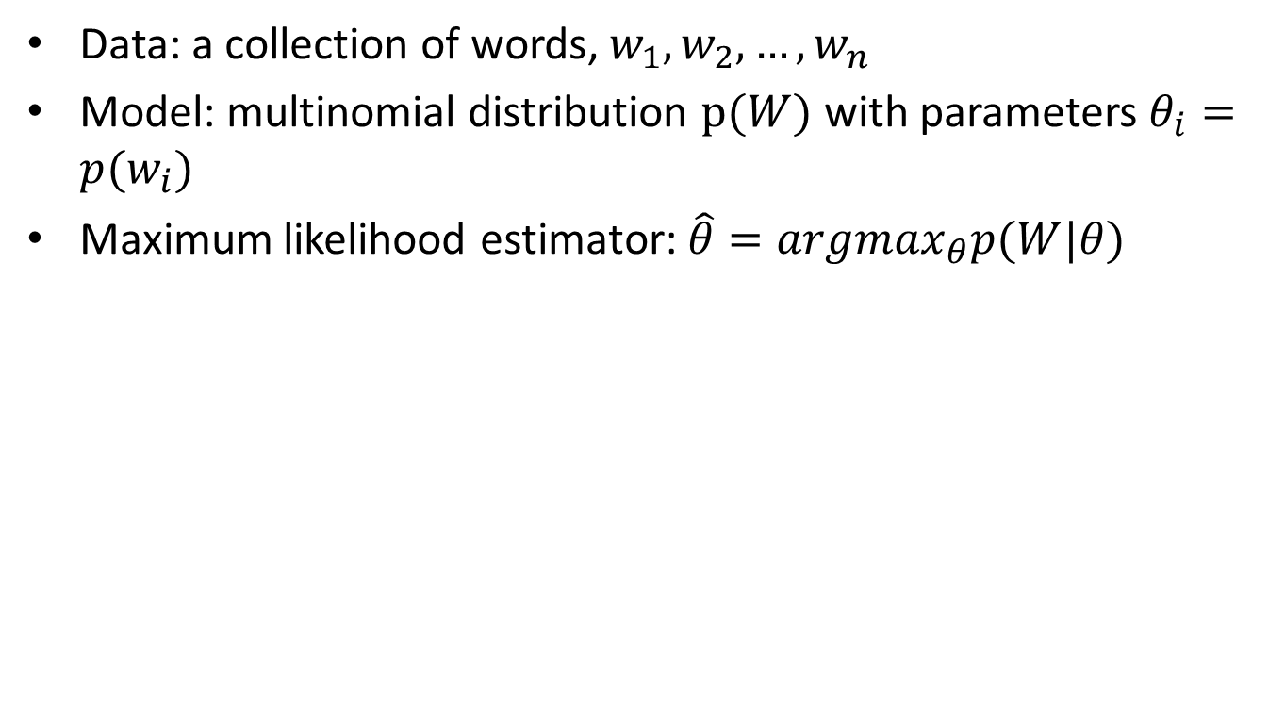
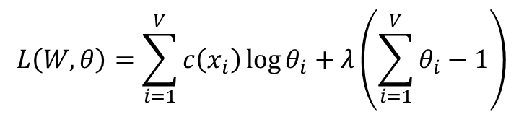
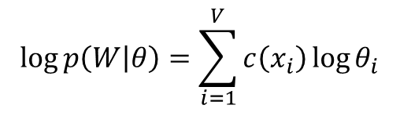

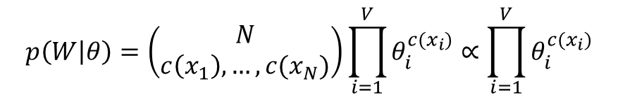

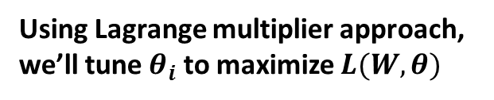
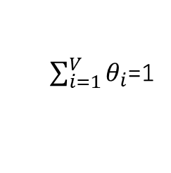
Maximum likelihood estimation
Data: a collection of words, $w_{1},w_{2},…,w_{n}$
Model: multinomial distribution $p(W)$ with parameters $θ_{i}=p(w_{i})$
Maximum likelihood estimator: $\hat{θ}=argmax_{θ}p(W|θ)$
$$p\left(W | θ\right)=\left(\begin{matrix}N \\ c\left(x_{1}\right),…,c(x_{N})\end{matrix}\right)\prod_{i=1}^{V}{θ_{i}^{c(x_{i})}}∝\prod_{i=1}^{V}{θ_{i}^{c(x_{i})}}$$
$$\log{p\left(W | θ\right)}=\sum_{i=1}^{V}{c\left(x_{i}\right)\log{θ_{i}}}$$
$$L\left(W,θ\right)=\sum_{i=1}^{V}{c\left(x_{i}\right)\log{θ_{i}}}+λ\left(\sum_{i=1}^{V}{θ_{i}}−1\right)$$
Using Lagrange multiplier approach, we’ll tune $θ_{i}$ to maximize $L(W,θ)$
$$\frac{∂L}{∂θ_{i}}=\frac{c\left(x_{i}\right)}{θ_{i}}+λ → θ_{i}=−\frac{c\left(x_{i}\right)}{λ}$$
Set partial derivatives to zero
$$λ=−\sum_{i=1}^{V}{c\left(x_{i}\right)}$$
Since
$\sum_{i=1}^{V}{θ_{i}}$=1
we have
Requirement from probability
$$θ_{i}=\frac{c\left(x_{i}\right)}{\sum_{i=1}^{V}{c\left(x_{i}\right)}}$$
ML estimate

Slide 19


Maximum likelihood estimation
For N-gram language models
$p\left(w_{i} | w_{i−1},…,w_{i−n+1}\right)=\frac{c(w_{i},w_{i−1},…,w_{i−n+1})}{c(w_{i−1},…,w_{i−n+1})}$
$c\left(∅\right)=N$
For the ease of notations, we denote $w_{i}$ as $w_{i}=x_{i}$ as the unique word type in vocabular
Length of document or total number of words in a corpus

Slide 20
Problem with MLE
Unseen events
We estimated a model on 440K word tokens, but:
Only 30,000 unique words occurred
Only 0.04% of all possible bigrams occurred
Estimation is very sparse!
You will expect many unseen, new word/N-grams existing in the test document.
This means any word/N-gram that does not occur in the training data has zero probability (according to the training corpus)!
No future documents can contain those unseen words/N-grams

Slide 21
Dealing with Unknown Words: The Simple Solution
Training:
Assume a fixed vocabulary (e.g. all words that occur at least twice (or n times) in the corpus)
Replace all other words by a token <UNK> (or a special OOV)
Estimate the model on this corpus
Testing:
Replace all unknown words by <UNK>
Run the model
This requires a large training corpus to work well!
Note: You cannot fairly compare two language models that apply different UNK treatments! Because their vocabulary is different

Slide 22
Smoothing
If we want to assign non-zero probabilities to unseen words
Unseen words = new words, new N-grams
Discount the probabilities of observed words
General procedure
Reserve some probability mass of words seen in a document/corpus
Re-allocate it to unseen words

Slide 23
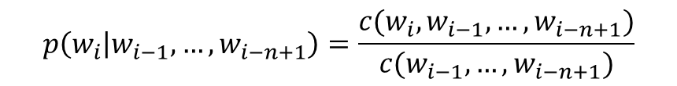

Illustration of N-gram language model smoothing
$$p\left(w_{i} | w_{i−1},…,w_{i−n+1}\right)$$
Max. Likelihood Estimate
$$p\left(w_{i} | w_{i−1},…,w_{i−n+1}\right)=\frac{c(w_{i},w_{i−1},…,w_{i−n+1})}{c(w_{i−1},…,w_{i−n+1})}$$
Smoothed LM
w
Discount from the seen words
Assigning nonzero probabilities to the unseen words

Slide 24

Smoothing methods
Additive smoothing
Add a constant δ to the counts of each word
Unigram language model as an example
Problems?
Hint: all words are equally important?
Counts of w in d
“Add one”, Laplace smoothing
$$p\left(w | d\right)=\frac{c\left(w,d\right)+δ}{\left|d\right|+δ|V|}$$
Vocabulary size
Length of d (total counts)

Slide 25
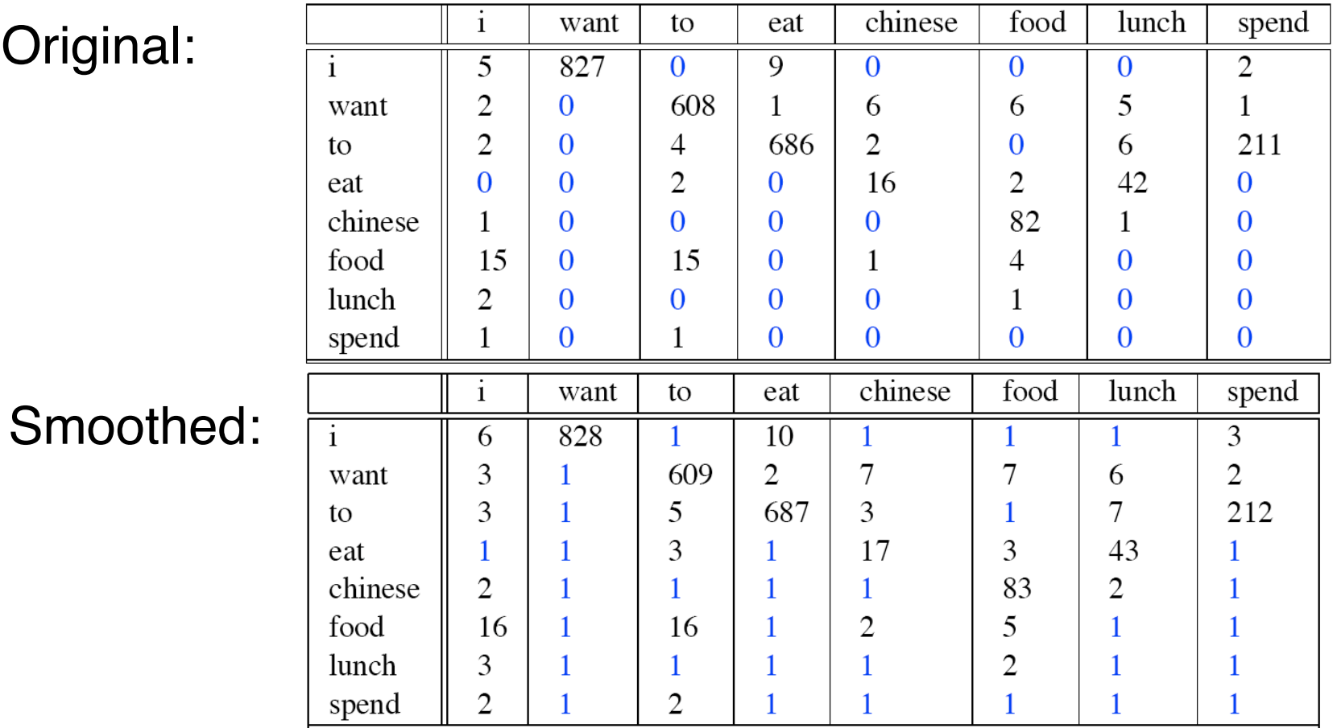
Add one smoothing for bigrams

Slide 26
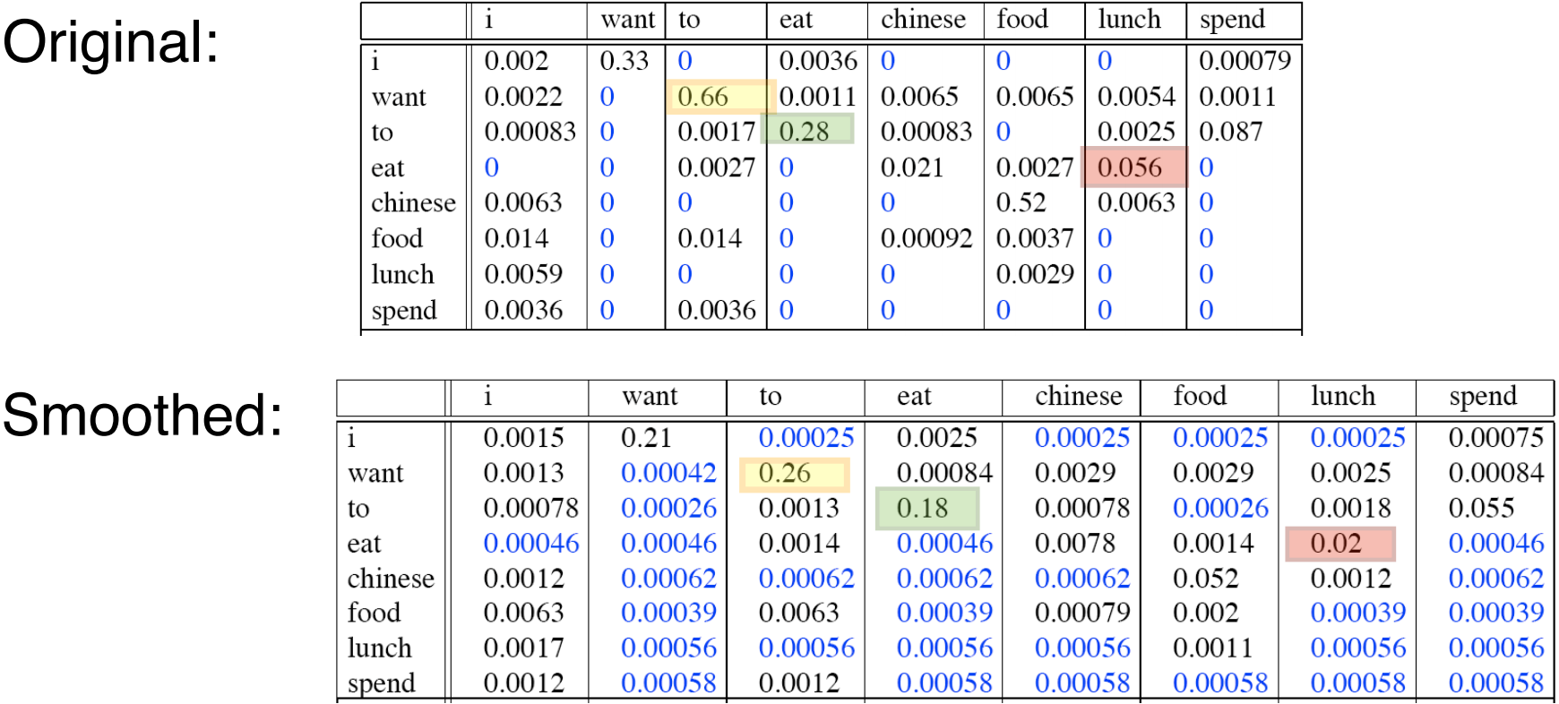
After smoothing
Giving too much to the unseen events
The probability of all seen events are reduced to much!
有一些bi-gram不可能出现，就不用分配给他们probability

Slide 27
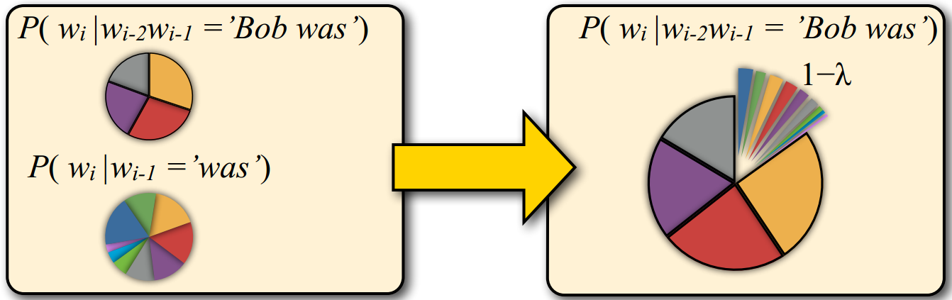
Smoothing methods
Linear interpolation
Use (N –1)-gram probabilities to smooth N-gram probabilities
We never see the trigram “Bob was reading”, but we do see the bigram “was reading”
Add small probabilities to “was reading” based on the knowledge about bi-gram language model.
1-λ: probabilities according to the N-1-gram language model.

Slide 28




Smoothing methods
Linear interpolation
Use (N –1)-gram probabilities to smooth N-gram probabilities
Further generalize it
ML N-gram
$$\overline{p}\left(w_{i} | w_{i−1},…,w_{i−n+1}\right)=λp_{ML}\left(w_{i} | w_{i−1},…,w_{i−n+1}\right)$$
$$+(1−λ)\overline{p}\left(w_{i} | w_{i−1},…,w_{i−n+2}\right)$$
Smoothed N-gram
Smoothed (N-1)-gram
$$\overline{p}\left(w_{i} | w_{i−1},…,w_{i−n+1}\right)=λ_{1}p_{ML}\left(w_{i} | w_{i−1},…,w_{i−n+1}\right)$$
$$+λ_{2}\overline{p}\left(w_{i} | w_{i−1},…,w_{i−n+2}\right)$$
…….
$$s.t. \sum_{i=1}^{n}{λ_{i}}=1$$
$$+λ_{n}\overline{p}(w_{i})$$

Slide 29

Smoothing methods
Linear interpolation
Estimating $λs$
Using a hold-out data set to find the optimal $λs$
An evaluation metric is needed to define “optimality”
Define $λ$ as a function of $w_{i−1},…,w_{i−n+2}$

Slide 30
Language model evaluation
Train the models on the same training set
Parameter tuning can be done by holding off some training set for validation
Test the models on an unseen test set
This data set must be disjoint from training data
Language model A is better than model B
If A assigns higher probability to the test data than B

Slide 31
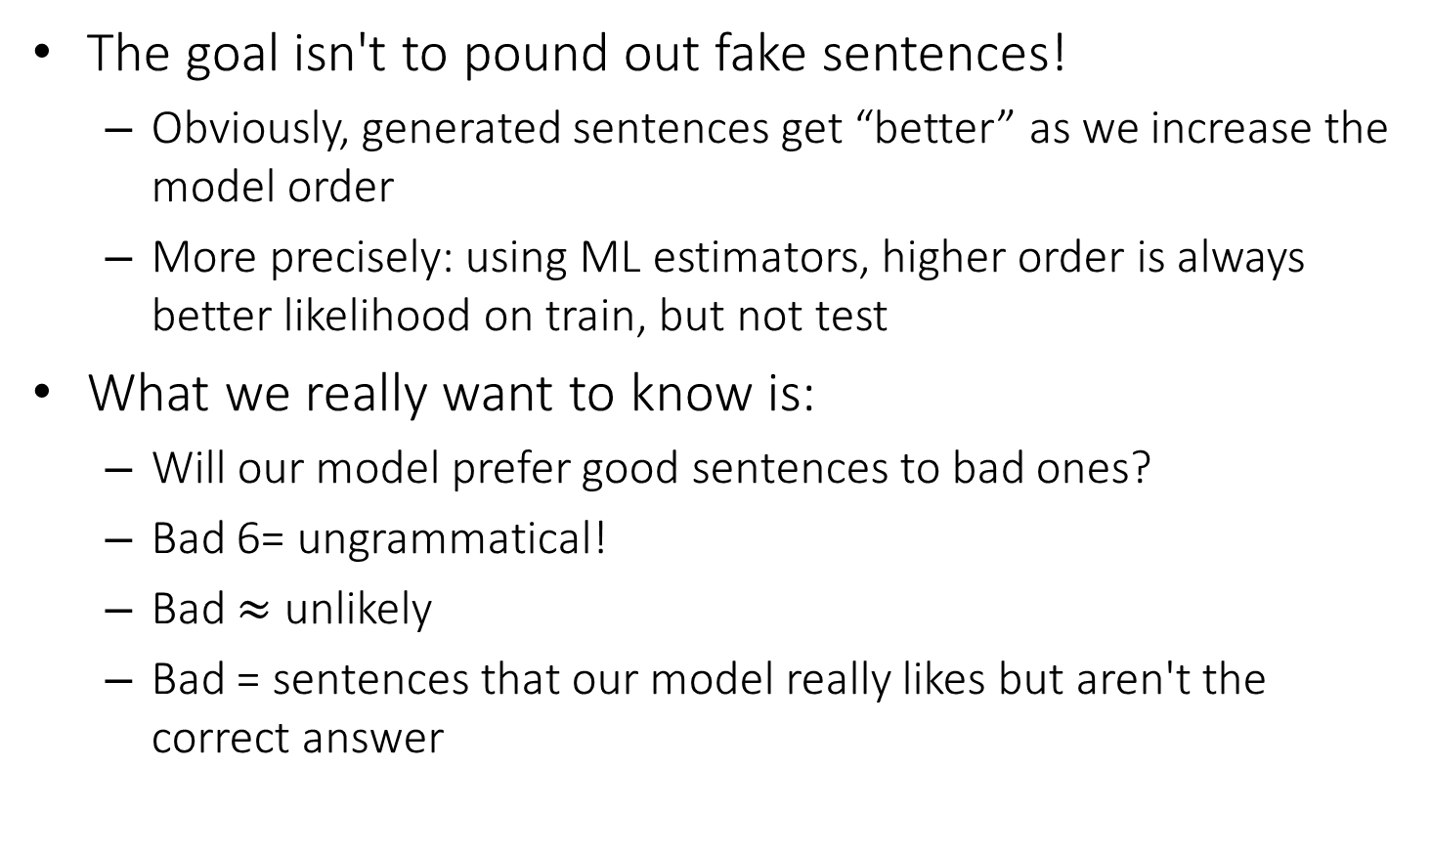
Measuring Model Quality
The goal isn't to pound out fake sentences!
Obviously, generated sentences get “better” as we increase the model order
More precisely: using ML estimators, higher order is always better likelihood on train, but not test
What we really want to know is:
Will our model prefer good sentences to bad ones?
Bad 6= ungrammatical!
Bad $≈$ unlikely
Bad = sentences that our model really likes but aren't the correct answer

Slide 32
Perplexity
Standard evaluation metric for language models
A function of the probability that a language model assigns to a data set
Rooted in the notion of cross-entropy in information theory

Slide 33
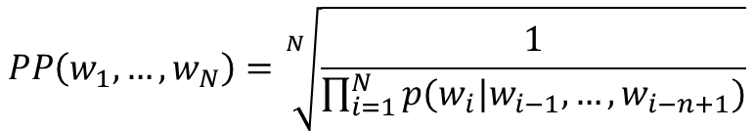
Perplexity
The inverse of the likelihood of the test set as assigned by the language model, normalized by the number of words
$$PP\left(w_{1},…,w_{N}\right)=\sqrt[N]{\frac{1}{\prod_{i=1}^{N}{p(w_{i}|w_{i−1},…,w_{i−n+1})}}}$$
N-gram language model

Slide 34
An experiment
Models
Unigram, Bigram, Trigram models (with proper smoothing)
Increase model complexity → smaller perplexity
Training data
38M words of WSJ text (vocabulary: 20K types)
Test data
1.5M words of WSJ text
Results
 | Unigram | Bigram | Trigram
Perplexity | 962 | 170 | 109

Slide 35
What Actually Works?
Trigrams and beyond
Unigrams, bigrams generally useless for speech or machine translation
Trigrams much better (when there's enough data)
4-, 5-grams really useful in MT(machine translation), but not so much for speech
Discounting (or smoothing)
Absolute discounting, Good-Turing, held-out estimation, Witten-Bell, etc.
See Chen and Goodman (1996) reading for tons of graphs
Chen, S. F. and Goodman, J. (1996). An empirical study of smoothing techniques for language modeling. In ACL, pages 310{318.

Slide 36
Data vs. Method?
Having more data is better...
...but so is using a better estimator
Another issue: n > 3 has huge costs in speech recognizers

Slide 37
Tons of Data?
Tons of data closes gap, for extrinsic MT evaluation
Thorsten Brants, Ashok C. Popat, Peng Xu, Franz J. Och, Jeffrey Dean. Large Language Models in Machine Translation. ACL, 2007 http://www.aclweb.org/anthology/D07-1090.pdf

Slide 38
What you should know
N-gram language models
How to generate text documents from a language model
How to estimate a language model
General idea and different ways of smoothing
Language model evaluation

Slide 39
Further reading
Speech and Language Processing
Chapter 4: N-Grams

